Slide 1
Gym website
React project
Full stack project

Slide 2

Important points
Amazing frontend
Getting mail message on login and booking
Using API (for exercises)
There will be three pages home, exercises, expandExercise
When user signup to my website I need to sent an email (a welcome email )
It is not compulsory to login for watching the website.
Color theme – primary bg , - , tertiary buttons/glow , - , secondary text
003049, d62828, f77f00, fcbf49, eae2b7

Slide 3
2. Login/Signup
Using firebase
Both in single page with animation

Slide 4

1. Nav bar
A logo,
Home, Pricing, About (programs, choose us, trainers, bmi, testimonials ), Exercises, Login/Signup
Transparent background(dark) and color white

Slide 5
3. Home
The main page or the landing page.
Contains various sections –
React slick photo with thumbnails
Programs
Why choose us
Trainers
Bmi calculator with dig
Various plans to purchase and send an email on purchasing, don’t add payment gateway.
Testimonials (In the video in phone)

Slide 6


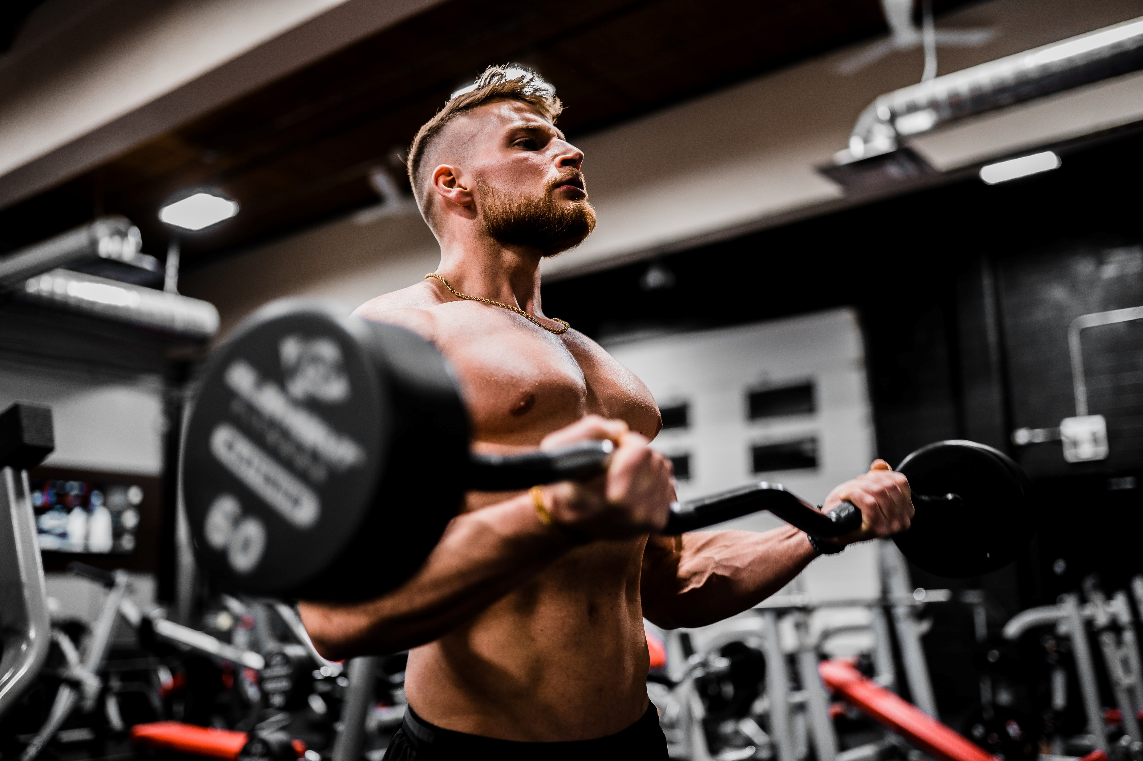
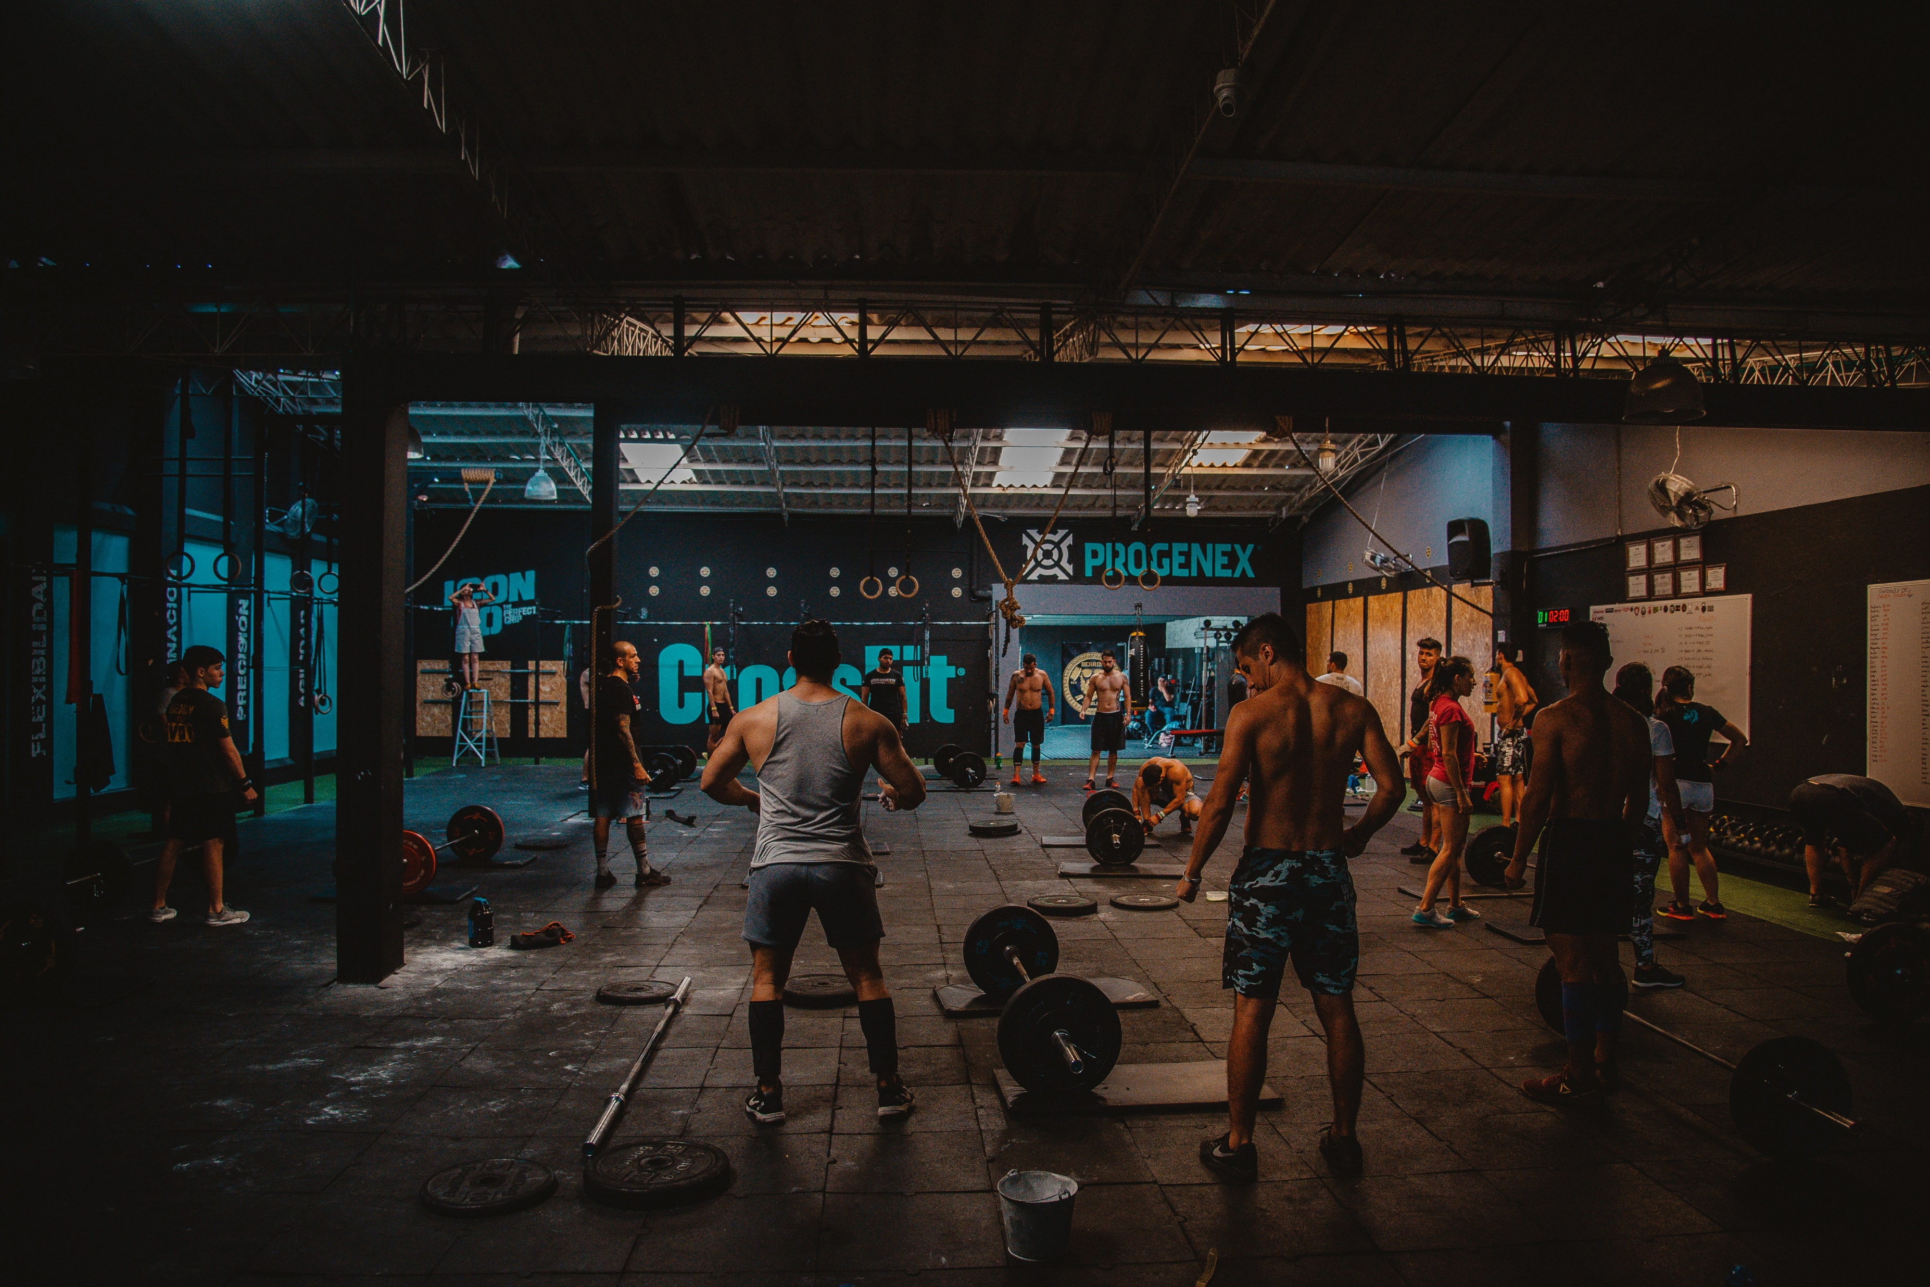


Section 1
Background images with react slick
Content remains same
No arrows just square dots at bottom with your tertiary color.
Be Smart be Fit (small)
Be stronger then your strongest excuse (extra large)
Join Now button
a13, a8, a3, a9, a1, a5

Slide 7

Section 2 (programs)
Muscle gain
Basic Yoga
Fat burning
Explore our programs (tertiary color)
Card with icon , heading, para, button(explore)
Icons from font awesome

Slide 8
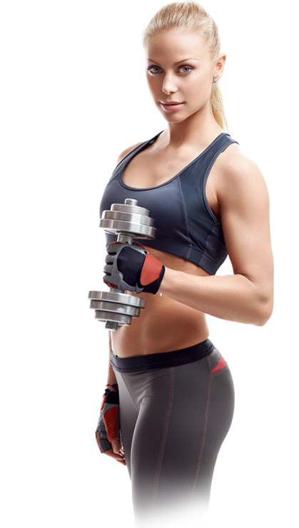
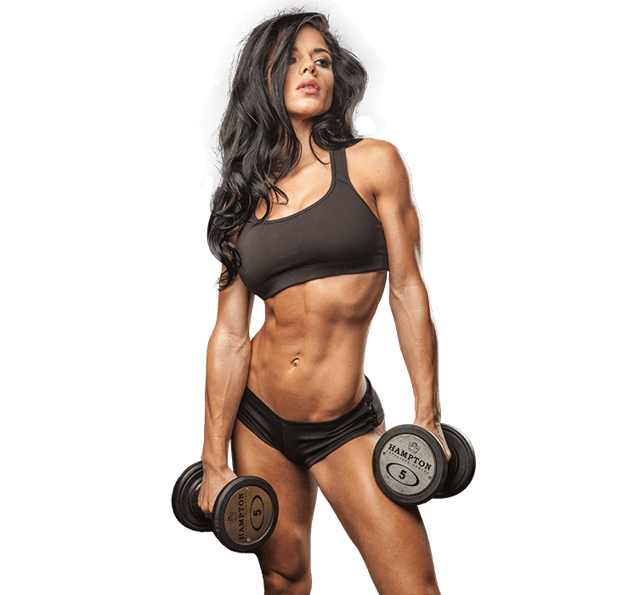

Section 3 (Why choose us)
Best reason
Why choose us ?
Modern gym filled with high tech equipment's and full of fun and motivation.
200+ members
50+ trainers
25+ programs
100+ awards

Slide 9




Section 4 (trainers)
Angela Rhodes, Janak Jain, Sourabh Mishra, Lana Khalifa

Slide 10
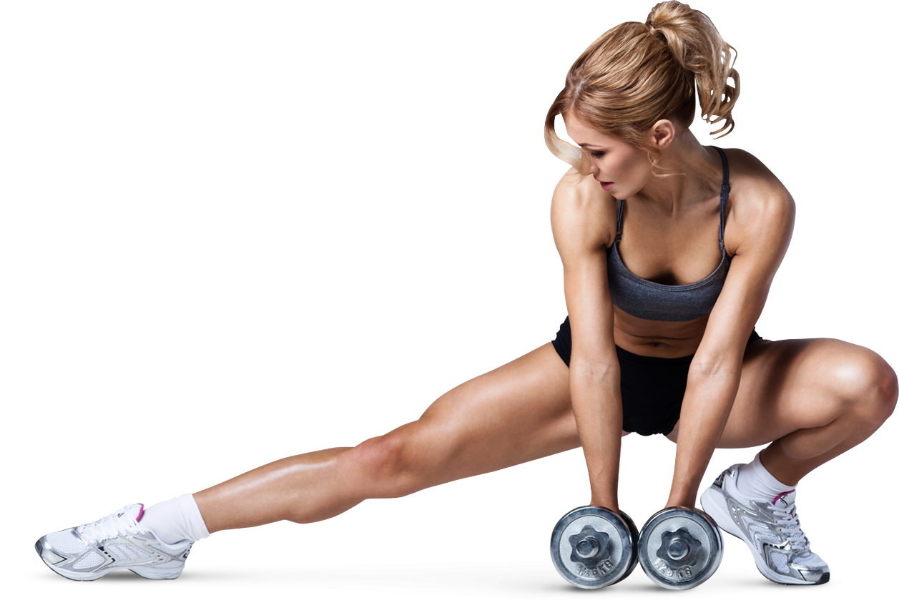
Section 5 (Bmi calculator)
Calculate your bmi
The best way to know that u are fit or not from your height and weight

Slide 11
Section 6 (various plans)
Basic plan, diamond plan(background of tertiary color), premium plan
01 Special gym T-shirt
01 Bottle of protein
Personal training
Access to videos
Expert Diet plans
A button of Purchase now (on click send an thankyou email) (if not logged in then show the login/signup popup)

Slide 12
Section 7 (testimonials)
Testimonials
What our clients say
We got more than 99% positive feedback from our members. Most used keywords in feedback are – Amazing, Best, Modern, Motivational, Power, Cardio, Muscles, Strength, Yoga, Success.
‘Read More’ button
Slider with cards (a para, a small circular photo and name)

Slide 13
Footer
With a input for email and sent a message on submitting the email.
With a feedback input and a message will be send to my email of the feedback with the user details.
4 sections –
Contact details – (icons) no., email, address, icons of social media
Quick links (home, pricing , programs, trainers, bmi, choose us)
Timings for gym Monday to Sunday
Newsletter(subscribe for latest updates, and a subscribe button)
Feedback textbox with submit button.
Email.js used for sending email from feedback form

Slide 14
4. Exercises
A different navbar as there are different options in exercises then home, the footer remains the same
Different sections in Exercises page :
Text on left and a picture on right
Carousal with all 10 body parts (on click that part gets searched)
Search bar
Exercises
Footer

Slide 15
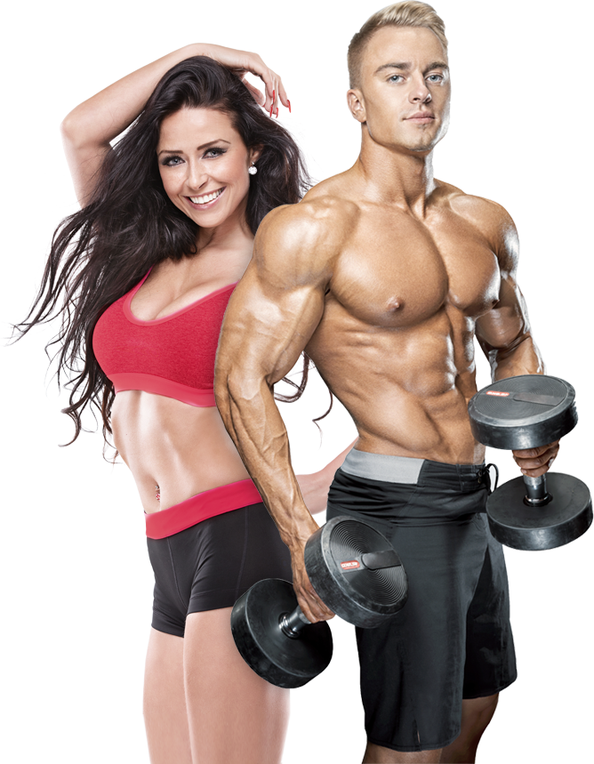
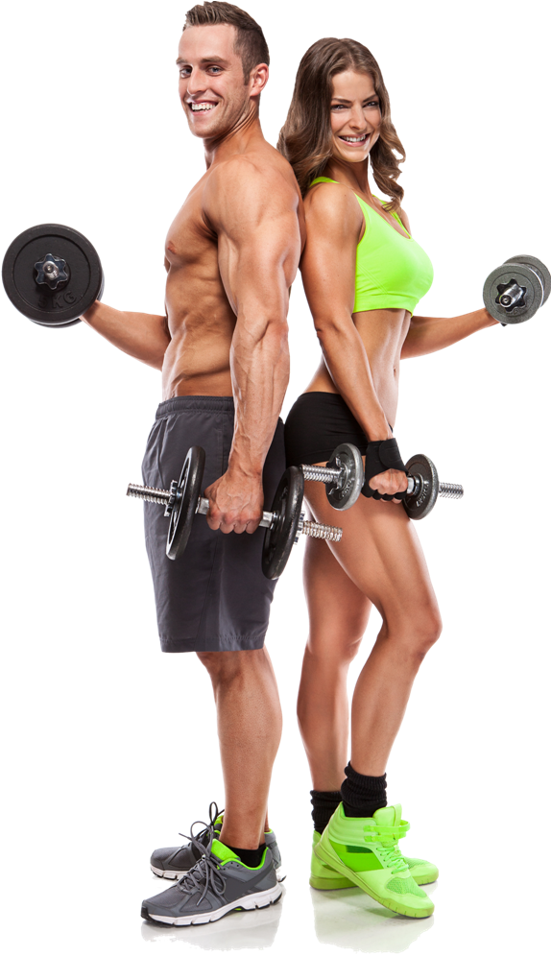
Esection 1
We have a collection of best choosen exercises from thousands of exercises for you
EAT
SLEEP
GYM
REPEAT

Slide 16
Esection 2
Cards as carousel - so that no need to search just click on the card and it will be automatically searched
10 cards – as 10 body parts
3 cards on a single page

Slide 17
Esection 3
Search bar ( dynamic )

Slide 18
Esection 4
Using API (https://rapidapi.com/justin-WFnsXH_t6/api/exercisedb/)
Exercises in grid, on click new page opens of expandExercise

Slide 19
5. Expand exercise

Slide 20
You can add
In nav bar, when u are on home the home button will glow and when u go to exercises that button start glowing or underline instead of glow.
Show some creativity in purchase now button (like a payment window will open with frontend but no backend, you can add offer of first order free and give them access for exercises), on clicking on exercises in nav a pop up show that “only for members”

Slide 21
What is left
Png image in section 3
Other social media platforms in login signup page
Add phone number verification or email verification using firebase in login signup (add update password)
Take picture of user and display on the right side of nav instead of a icon
Read more button in testimonials

